Slide 1

Tactical Analysis of a Bowler
K. ANIKETH

Slide 2

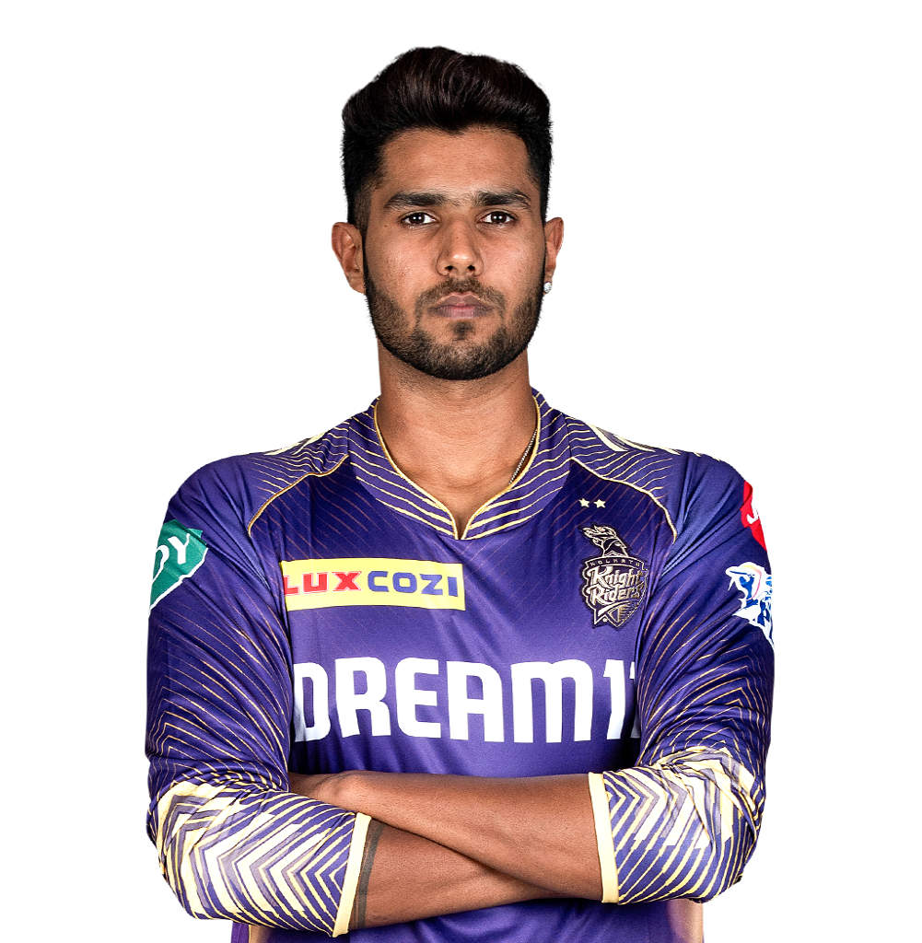
Harshit Rana
Rana’s Slow Ball Redemption

Slide 3
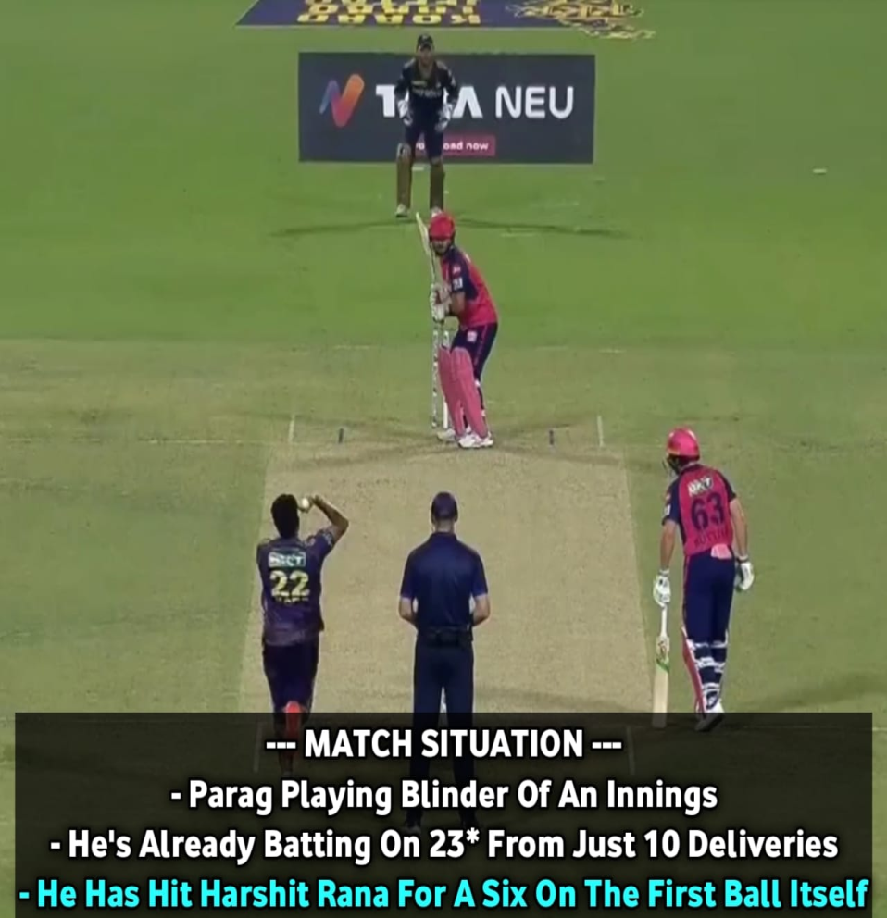
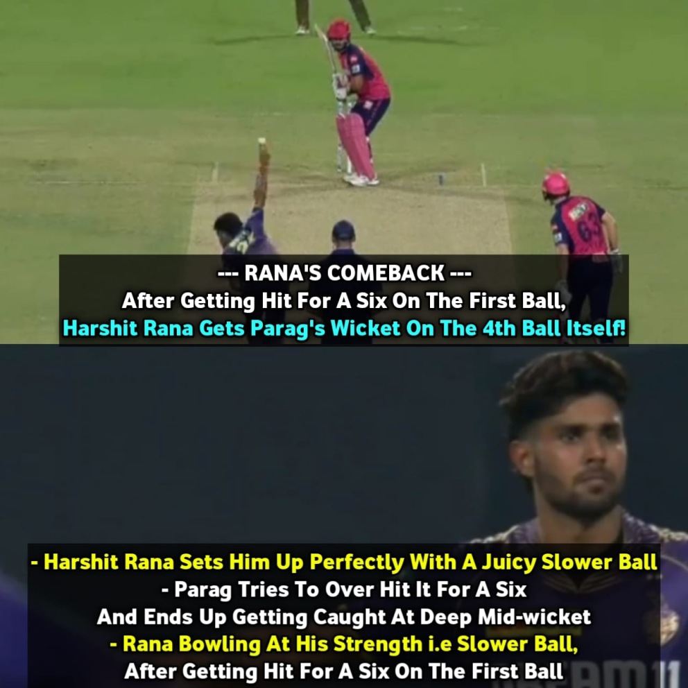
Rana vs Parag

Slide 4
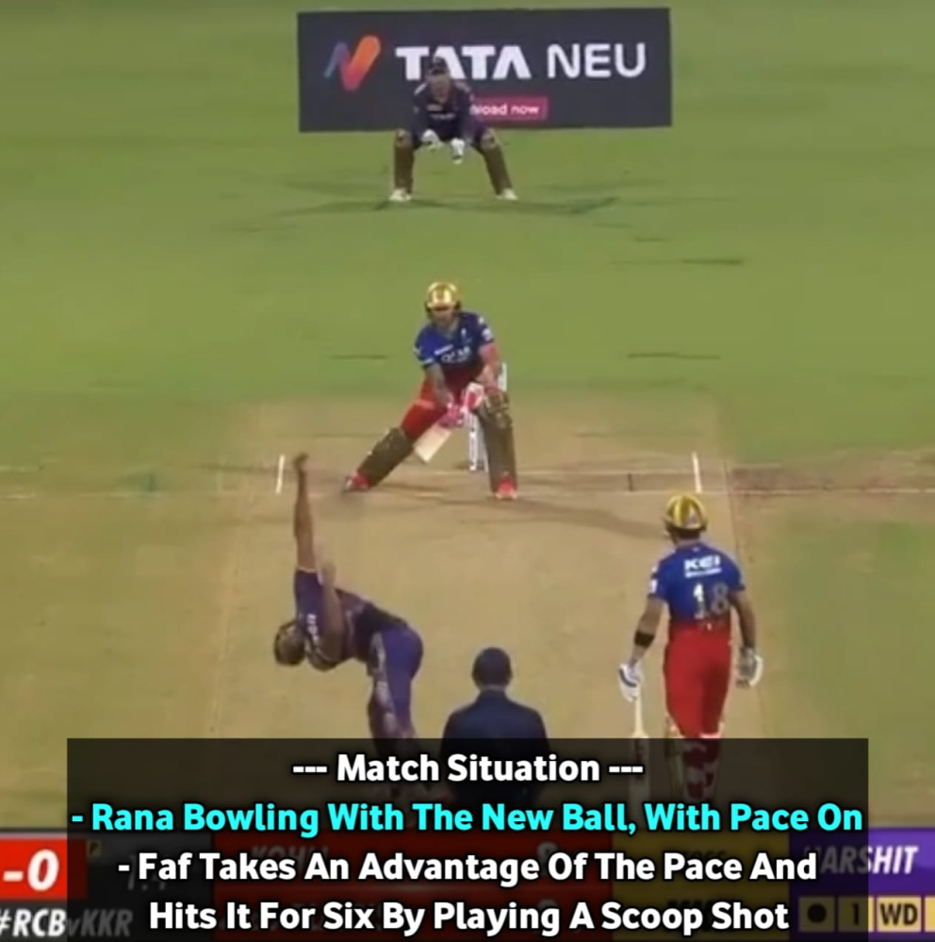
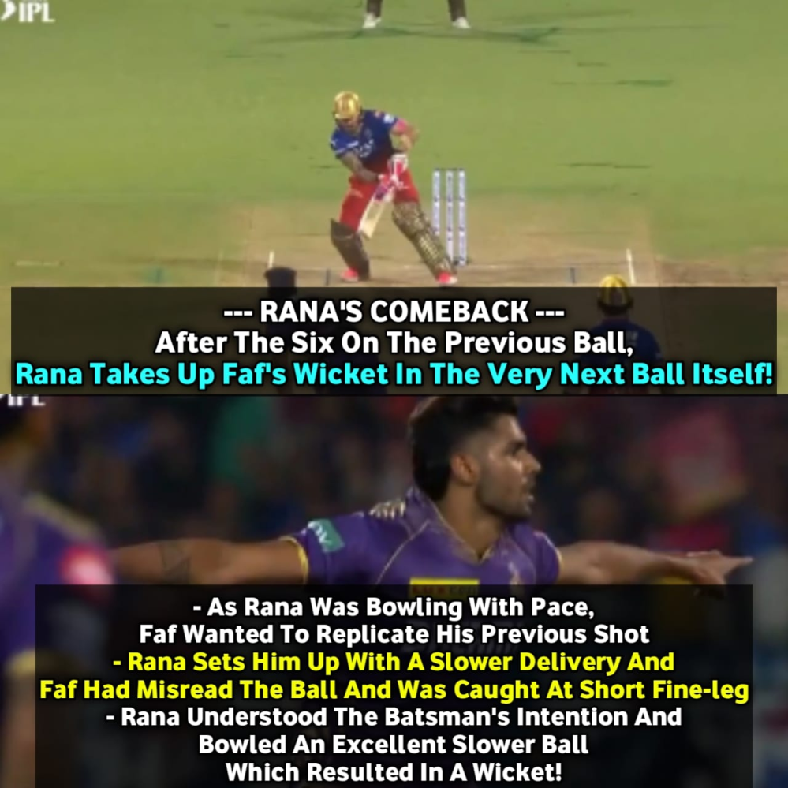
Rana vs Faf Du Plessis

Slide 5
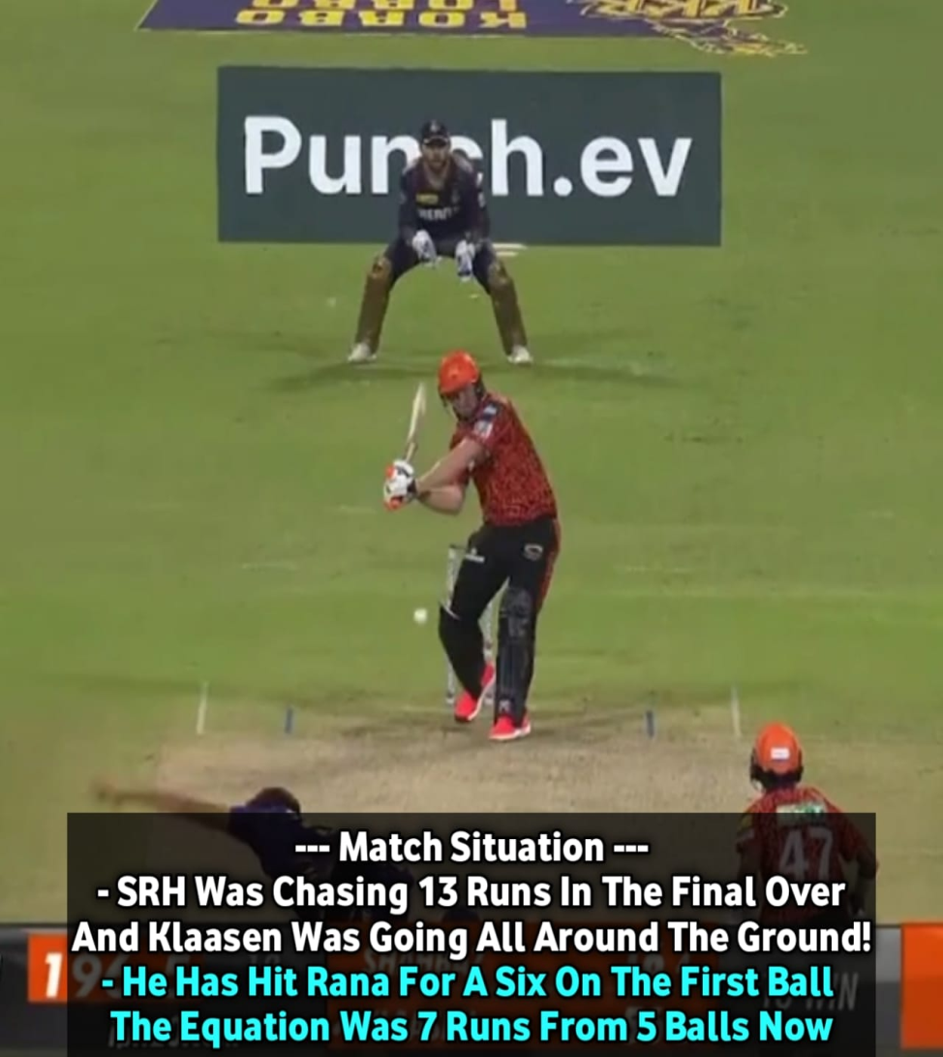
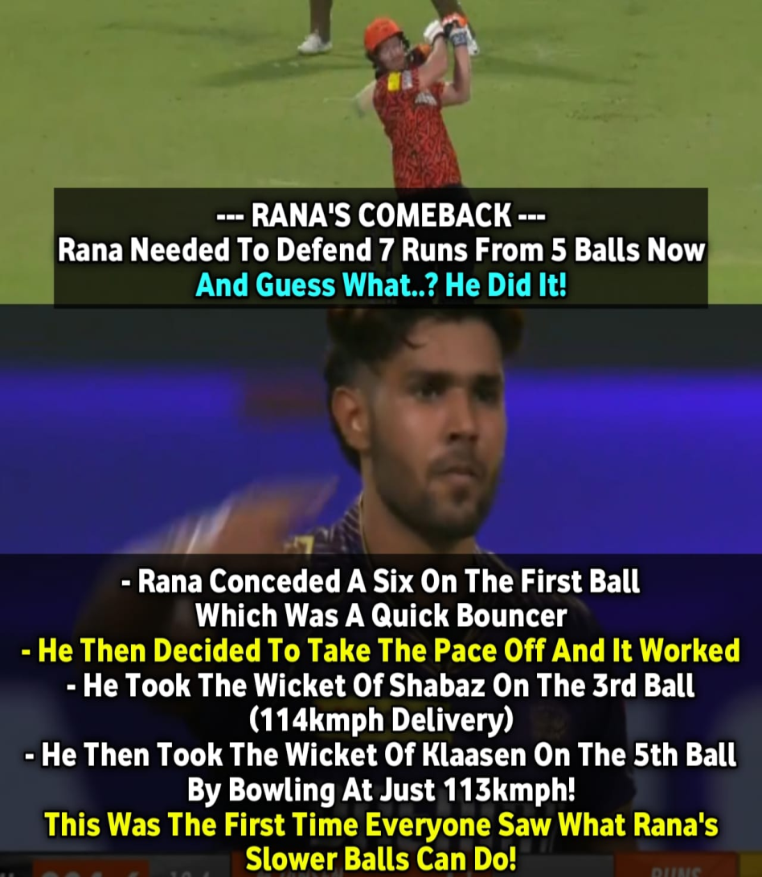
Rana vs Klaasen

Slide 6
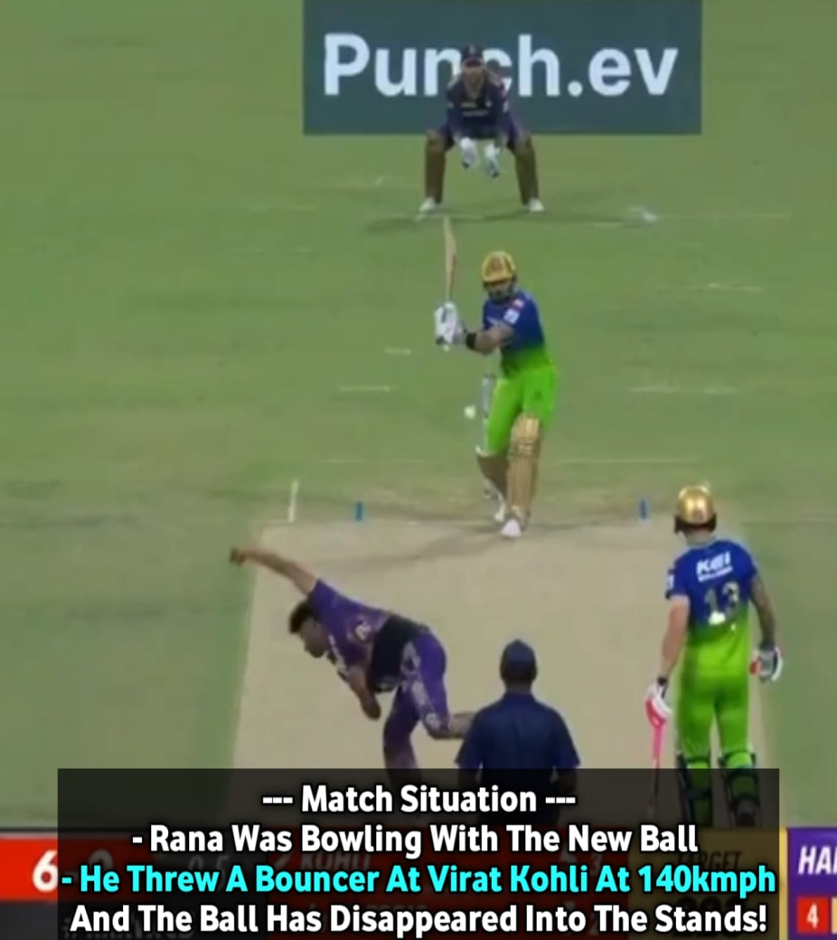
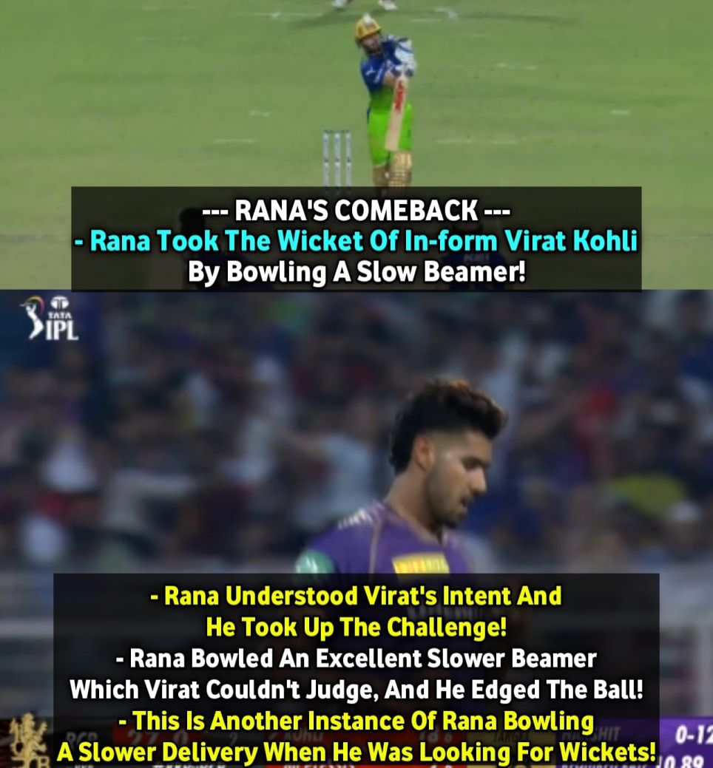
Rana vs Kohli

Slide 7
Change-up Specialist
Rana picked up 19 wickets in 13 games, the most by an uncapped Indian player.
His variations are executed really well in the middle overs, where he has the best economy rate of (7.88) among fast bowlers who have bowled atleast 100 balls in this phase.
Rana has a very good success rate when bowling slower balls. He has taken maximum wickets by bowling slower deliveries.
Nearly 13 out of the 19 wickets he claimed came from his skillful slower deliveries. Great job by Rana.

Slide 8
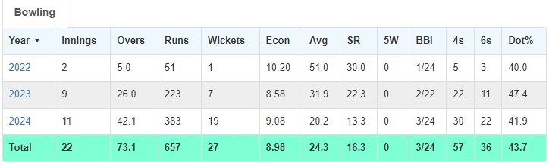
Stats

Slide 9
THANK YOU

